Slide 1

Amazon Recommendation System: How AI Predicts What You’ll Buy Next
Leland Jones, Earl Garner, Robby Heisey

Slide 2
What is a Recommendation System?
AI/ML algorithm that predicts user preferences
Uses past behavior to suggest items
Found in Amazon, Netflix, YouTube, and many more
Systems filter massive amounts of data
They rely on patterns from user interactions

Slide 3
Why Amazon Needs It
Millions of products
Millions of users
Too much data to browse manually
Users would struggle to find products
Amazon uses AI/ machine learning to reduce decision overload

Slide 4

High-Level System Overview
Amazon tracks:
User behavior
Product attributes
Products a user has saved and listed
Products purchased and rates
Trending products
Location
User reviews
Recommendations are generated in real time based on users’ real-time activity
They are everywhere (home page, product pages, & checkout pages)

Slide 5
Collaborative Filtering
Goal is to find patterns and similarities in the data among users
Connects users with similar preferences and recommends items
Predicts preferences using data from many users

Slide 6
Content-Based Filtering
Titles
Categories
Descriptions
Specifications

Slide 7
A9/A10
A9 - Focused on keyword matching and conversion rates
A10 – Focused on organic sales, external traffic, brand authority, customer satisfaction signals
Notes:
This is Amazon’s recommendation systems. A9 being the older one and A10 being the newer one

Slide 8
The algorithms framework
Relevance
Click Performance
Conversion Performance
Sales Velocity
Customer Experience Signals
Notes:
Relevance – Determines whether the product appears in search results
Click Performance – Click Through Rate: A higher CTR signals relevance and increases its ranking. Neural Networks are used here.
Conversion Performance – Measures how many visitors convert into buyers. Higher rate, higher ranking
Sales Velocity – Products sells overtime. Focuses on product demand, customer satisfaction, and market relevance
Customer Experience Signals – checks return rate and feedback. Poor experience can negatively impact the ranking.

Slide 9
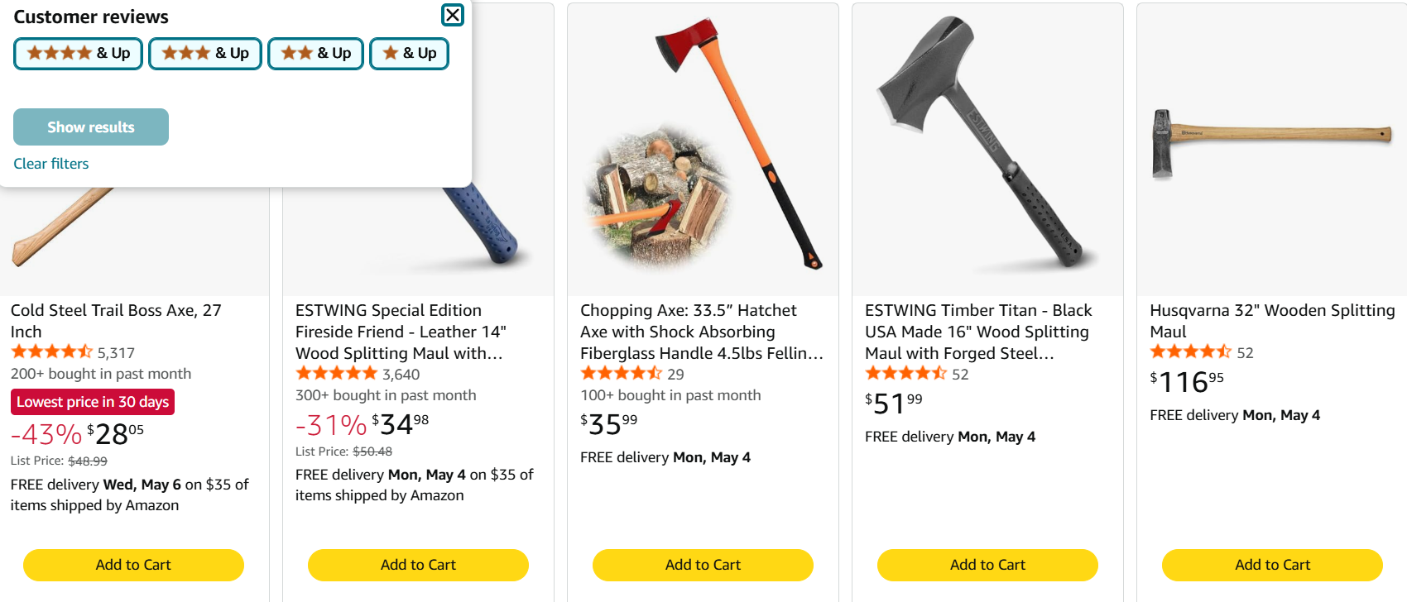

Slide 10

Challenges
Cold start problem
Data sparsity
Bias toward popular items
Notes:
Cold Start – New users/products = no data
Data sparsity- happens when there is not enough interaction data between users and items. Most user only interact with a tiny part of all of the products.

Slide 11

Python Code
https://github.com/LelandJones/Amazon-Recommendation-System-Final-Project/tree/main/code

Slide 12

Real Amazon Impact
McKinsey Study: 35% of sales
Enhanced customer experience
Product Discovery
Higher conversion rates
Efficient Inventory management
Data-Driven Insights – customer preferences and behaviors

Slide 13
Conclusion
Amazon uses AI to predict behavior
Item-based filtering is the foundation
Modern systems use advanced ML

Slide 14
Sources
https://www.shiprocket.in/blog/amazon-recommendation/
https://stratoflow.com/amazon-recommendation-system/
https://www.amazon.science/the-history-of-amazons-recommendation-algorithm
https://www.baeldung.com/cs/amazon-recommendation-system
How Amazon Algorithm Works (2026): A9 & A10 Explained

